Slide 1

CVR COLLEGE OF ENGINEERING DEPARTMENT OF CSE (DATA SCIENCE) Advanced Data Structures through java Rotations in AVL Trees (Single and Double rotations)
Sravanthi CSD-A
23B81A6749

Slide 2
What is an AVL Tree?
An AVL tree is a type of binary search tree. Named after it's inventors Adelson, Velskii, and Landis, AVL trees have the property of dynamic self-balancing in addition to all the other properties exhibited by binary search trees.

Slide 3
AVL Tree Rotations
In AVL trees, after each operation like insertion and deletion, the balance factor of every node needs to be checked. If every node satisfies the balance factor condition, then the operation can be concluded. Otherwise, the tree needs to be rebalanced using rotation operations.
There are four rotations and they are classified into two types:
1) Left Rotation (LL Rotation)
2) Right Rotation (RR Rotation)
3) Left-Right Rotation (LR Rotation)
4) Right-Left Rotation (RL Rotation)

Slide 4
–
Balancing and Balance Factor
The balancing condition of AVL tree:
Balance factor = height(Left subtree) – height(Right subtree),
And it should be -1, 0 or 1. Other than this will cause restructuring (or balancing) the tree.
Balancing performed is carried in the following ways,

Slide 5
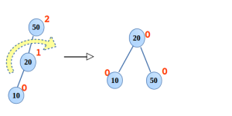
Right rotation(RR)
In the binary search tree shown below is a case of right rotation. There is a single rotation required at the root 50, done as followed,
20 will be the new root.
50 takes ownership of 20’s right child,
10 is still the left child of 20.

Slide 6
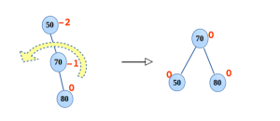
Left rotation(LL)
In the binary search tree shown below is a case of left rotation where required. There is a single rotation required at the root 50, done as followed,
70 will be the new root.
50 takes ownership of 70’s left child.
80 is still the right child of 70.

Slide 7
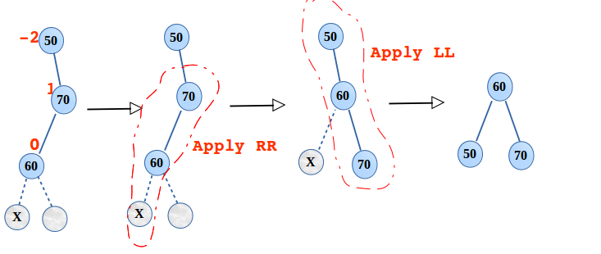
Left right double rotation(LR)
LR Rotation
shown below is the case of LR rotation, here two rotations are performed. First RR and then, LL as follows,
Right rotation is applied at 70, after restructuring, 60 takes the place of 70 and 70 as the right child of 60.
Now left rotation is required at the root 50, 60 becomes the root. 50 and 70 become the left and right child respectively.

Slide 8
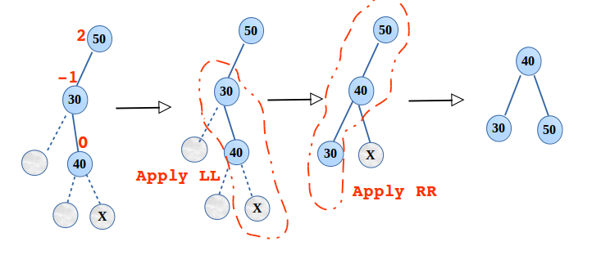
Right left double rotation(RL)
RL Rotation
Shown below is the case of RL rotation, here two rotations are performed. First LL and then, RR as follows,
Left rotation is applied at 30, after restructuring 40 takes the place of 30 and 30 as the left child of 40.
Now right rotation is required at the root 50, 40 becomes root. 30 and 50 becomes the left and right child respectively.

Slide 9
Thank You

